Slide 1

STAGING DELL’OBESITA’.
Lancet commission e framework EASO. Esistono convergenze?
Luca busetto
uNIVERSITà DI PADOVA

Slide 2



Luca Busetto
Full Professor of Nutrition, Department of Medicine
University of Padova
Director of the Cinical Nutrition Unit
Padova University Hospital
Centre for the Study and the Integrated management of Obesity
Padova University Hospital
Vice President of European Association for the Study of Obesity
Past President of the Italian Obesity Society (SIO)

Slide 3
Luca Busetto - Disclosures
ADVISORY BOARD MEMBER: - AMGEN
- BOEHRINGER INGELHEIM
- BRUNO FARMACEUTICI
- ELI LILLY
- NOVONORDISK - PFIZER
                - RECORDATI
                - REGENERON
                - ROCHE
SPEAKER FEES - PRONOKAL
- RYTHM PHARMACEUTICALS

Slide 4
Evolution of guidelines
Approval of new generation anti-obesity medications
2013
2019
2020
2021
2022
2023
2024
2025
Obesity Canada 2022 guideline updates
EASO framework
AMA resolution
ACC/AHA/TOS guidelines
EASO declaration
AOASO Nagoya declaration
ENDO/ESE/TOS clinical practice guidelines
AACE/ACE clinical practice guidelines
Academy of Nutrition and Dietetics
position statement
World Obesity Federation position statement
Clinical practice recommendations for obesity management in the UAE
Royal College of Physicians statement
European Practical and Patient-Centred
Guidelines for Adult Obesity Management in
Primary Care
Obesity Canada guidelines
JASSO Guidelines for the Management of Obesity
Obesity Algorithm for ORCs
AACE/TOS/ASMBS/OMA/ASA CPG
Lancet Commission
definition and diagnostic criteria
ASMBS/IFSO Indications for Metabolic and Bariatric Surgery
NICE guidelines
AGA guidelines
ADA Obesity Association guidelines
European Commission Obesity Prevention document¹⁷
Obesity Algorithm for ORCs update
Obesity Canada 2025
guideline updates
EASO algorithm
Notes:
1. AMA. Recognition of Obesity as a Disease. 2013. Resolution 420, (A-13). Available at: http://media.npr.org/documents/2013/jun/ama-resolution-obesity.pdf. Accessed June 2025;
2. Jensen MD et al. J Am Coll Cardiol 2014;63(25_PB):2985–3023;
3. Frühbeck G et al. Obes Facts 2016;9:296–8;
4. AOASO position statement, Nagoya Declaration 2015. Available at: https://www.c-linkage.co.jp/aoco2015/data/declaraN-en.pdf. Accessed June 2025.
5. Apovian CM et al. J Clin Endocrinol Metab. 2015;100:342-62;
6. Garvey WT et al. Endocr Pract 2016;22(Suppl 3):1–203;
7. Raynor et al. J Acad Nutr Diet 2016;116:129‒47;
8. Bray et al. Obes Rev 2017;18:715–23;
9. Abusnana S et al. Obes Facts 2018;11:413-28;
10. Kmietowicz Z. BMJ 2019;364:l45;
11. Durrer Schutz D et al. Obes Facts 2019;12:40-66;
12. Obesity Canada. Available at https://obesitycanada.ca/guidelines/. Accessed April 2025;
13. AACE/TOS/ASMBS/OMA/ASA Clinical Practice Guidelines for the Perioperative Nutritional, Metabolic, and Nonsurgical Support of the Bariatric Surgery Patient – 2020 Update. Available at: https://asmbs.org/resources/aace-tos-asmbs-oma-asa-clinical-practice-guidelines-for-the-perioperative-nutritional-metabolic-and-nonsurgical-support-of-the-bariatric-surgery-patient-2020/ Accessed June 2025;
14. Ogawa W et al. Endocr J 2024;71:223-231.
15. Eisenberg D et al. Surg Obes Relat Dis. 2022;18:1345-56.
16. Grunvald E et al. Gastroenterology 2022;163:1198–225;
17. European Commission. Obesity prevention. Available from https://knowledge4policy.ec.europa.eu/health-promotion-knowledge-gateway/obesity_en. Accessed April 2025;
18. EASO. A new framework for the diagnosis, staging and management of obesity in adults. Available at: https://easo.org/a-new-framework-for-the-diagnosis-staging-and-management-of-obesity-in-adults/ Accessed April 2025;
19. Obesity Medicine Association Obesity Algorithm 2024. Available from: https://obesitymedicine.org/resources/obesity-algorithm/. Accessed June 2025;
20. Rubino F et al. Lancet Diab & Endocrinol 2025;13;221–62;
21. Overweight and obesity management NICE Guideline NG246. Available at: https://www.nice.org.uk/guidance/ng246. Accessed June 2025;
22. Bannuru RR. BMJ Open Diabetes Res Care 2025;13(Suppl 1):e004962;
23. Obesity Medicine Association Obesity Algorithm 2025. https://obesitymedicine.org/resources/obesity-algorithm/;
24. EASO obesity medication algorithm. Presented at the 32nd European Congress on Obesity, 11–14 May 2025, Malaga, Spain.
1. AMA. Recognition of Obesity as a Disease. 2013. Resolution 420, (A-13). Available at: http://media.npr.org/documents/2013/jun/ama-resolution-obesity.pdf. Accessed June 2025; 2. Jensen MD et al. J Am Coll Cardiol 2014;63(25_PB):2985–3023; 3. Frühbeck G et al. Obes Facts 2016;9:296–8; 4. AOASO position statement, Nagoya Declaration 2015. Available at: https://www.c-linkage.co.jp/aoco2015/data/declaraN-en.pdf. Accessed June 2025; 5. Apovian CM et al. J Clin Endocrinol Metab. 2015;100:342-62; 6. Garvey WT et al. Endocr Pract 2016;22(Suppl 3):1–203; 7. Raynor et al. J Acad Nutr Diet 2016;116:129‒47; 8. Bray et al. Obes Rev 2017;18:715–23; 9. Abusnana S et al. Obes Facts 2018;11:413-28; 10. Kmietowicz Z. BMJ 2019;364:l45; 11. Durrer Schutz D et al. Obes Facts 2019;12:40-66; 12. Obesity Canada. Available at https://obesitycanada.ca/guidelines/. Accessed April 2025; 13. AACE/TOS/ASMBS/OMA/ASA Clinical Practice Guidelines for the Perioperative Nutritional, Metabolic, and Nonsurgical Support of the Bariatric Surgery Patient – 2020 Update. Available at: https://asmbs.org/resources/aace-tos-asmbs-oma-asa-clinical-practice-guidelines-for-the-perioperative-nutritional-metabolic-and-nonsurgical-support-of-the-bariatric-surgery-patient-2020/ Accessed June 2025; 14. Ogawa W et al. Endocr J 2024;71:223-231; 15. Eisenberg D et al. Surg Obes Relat Dis. 2022;18:1345-56; 16. Grunvald E et al. Gastroenterology 2022;163:1198–225; 17. European Commission. Obesity prevention. Available from https://knowledge4policy.ec.europa.eu/health-promotion-knowledge-gateway/obesity_en. Accessed April 2025; 18. EASO. A new framework for the diagnosis, staging and management of obesity in adults. Available at: https://easo.org/a-new-framework-for-the-diagnosis-staging-and-management-of-obesity-in-adults/ Accessed April 2025; 19. Obesity Medicine Association Obesity Algorithm 2024. Available from: https://obesitymedicine.org/resources/obesity-algorithm/. Accessed June 2025; 20. Rubino F et al. Lancet Diab & Endocrinol 2025;13;221–62; 21. Overweight and obesity management NICE Guideline NG246. Available at: https://www.nice.org.uk/guidance/ng246. Accessed June 2025; 22. Bannuru RR. BMJ Open Diabetes Res Care 2025;13:e004962; 23. Obesity Medicine Association Obesity Algorithm 2025. https://obesitymedicine.org/resources/obesity-algorithm/; 24. EASO obesity medication algorithm. Presented at the 32nd European Congress on Obesity, 11–14 May 2025, Malaga, Spain.

Slide 5

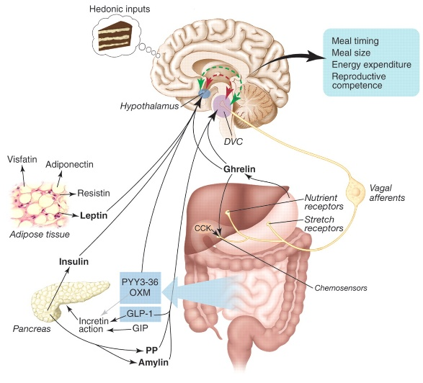

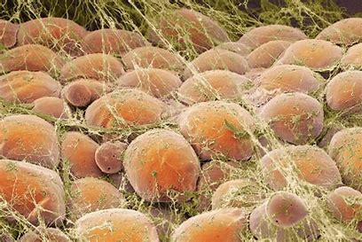
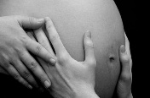





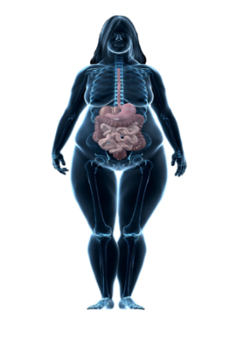
Obesity pathophysiology framework
↓ satiety
↑ hunger
↑ desire for food
Mechanical
Metabolic
Systemic inflammation
T2D
CVD

Slide 6
Obesity Related Complications

Slide 8
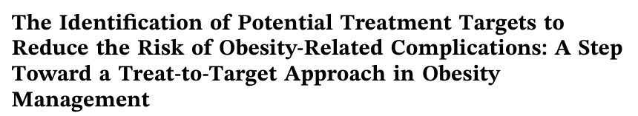
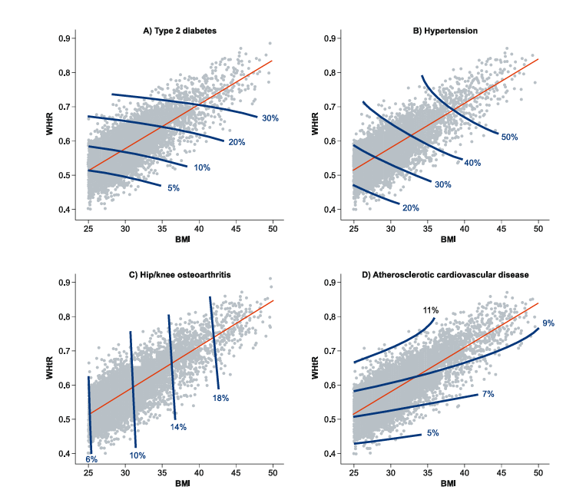
499,813 people
from UK CPRD Aurum
T2D, hypertension, hip/knee OA and ASCVD
Baseline BMI
and WHtR
10-year risk for a 50-year-old male
Busetto L et al. Obes Sci Pract 2025;11:e70094

Slide 9

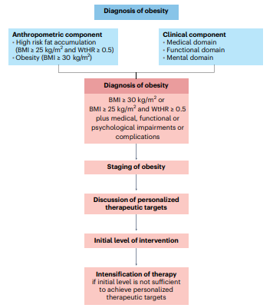

Busetto L et al. Nat Med 2024;30:2395-2399

Slide 10

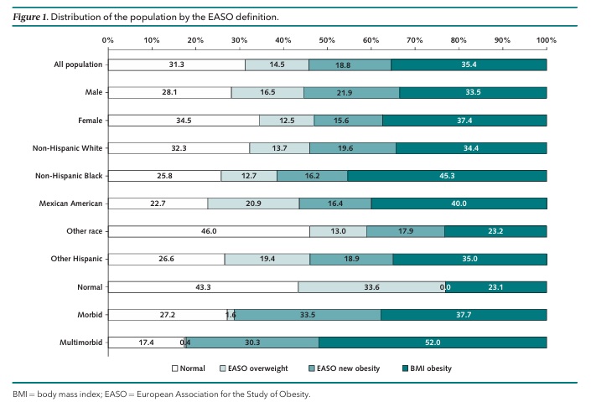
Dicker D et al. Ann Int Med 2025; 178:1065-1072

Slide 11
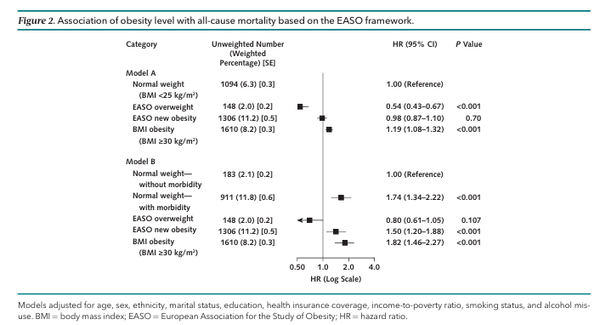
Dicker D et al. Ann Int Med 2025; 178:1065-1072

Slide 12

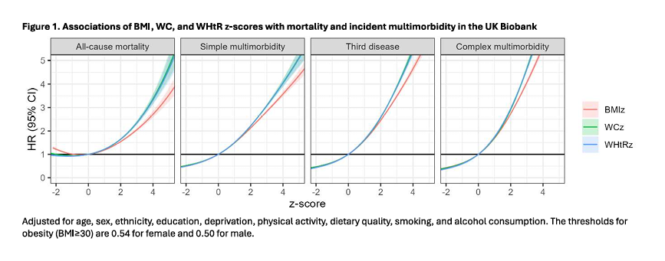
Ho F et al. medRxiv [Preprint] 2025 Oct 19

Slide 13
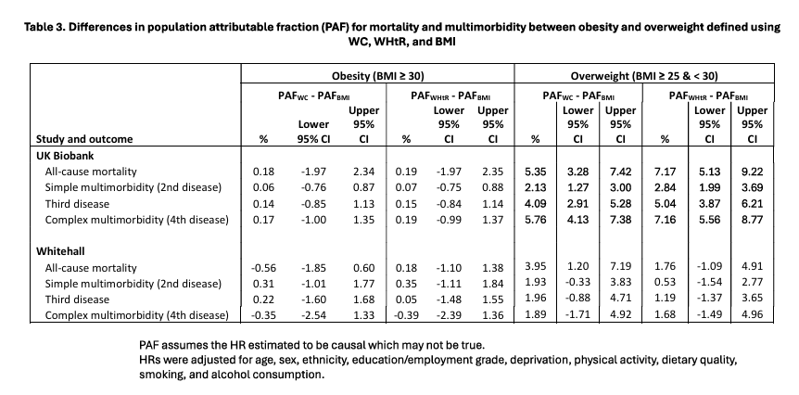
Ho F et al. medRxiv [Preprint] 2025 Oct 19

Slide 14

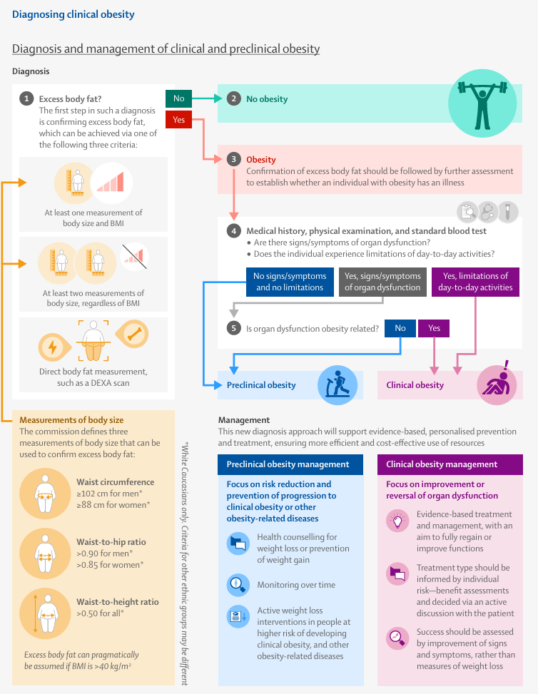
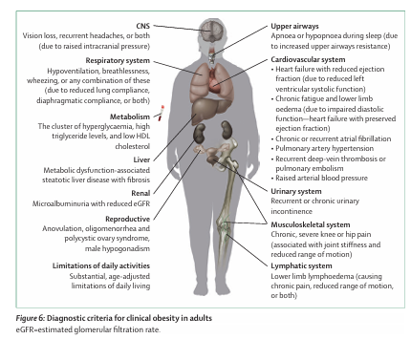
Rubino F et al. Lancet Diab Endocrinol 2025;13:221-262

Slide 15
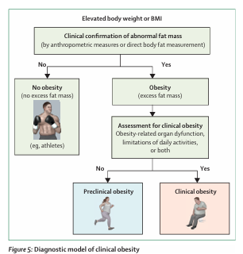
Rubino F et al. Lancet Diab Endocrinol 2025;13:221-262

Slide 16
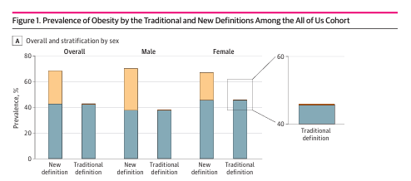

Fourman LT et al JAMA Netw Open 2025;8:e2537619.

Slide 17
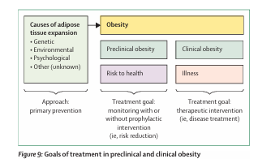
Rubino F et al. Lancet Diab Endocrinol 2025;13:221-262

Slide 18
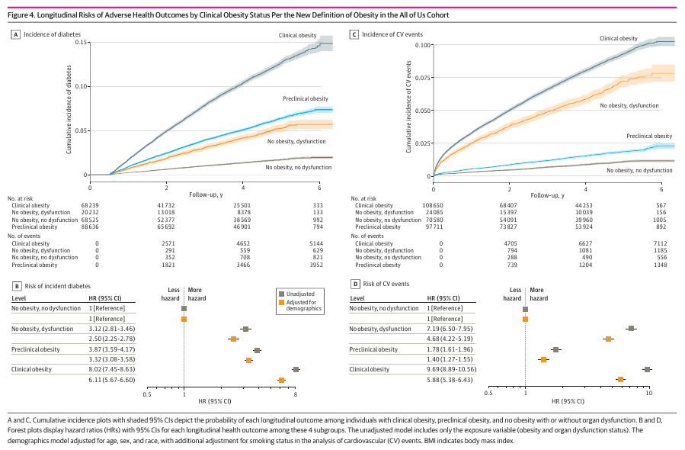
Fourman LT et al JAMA Netw Open 2025;8:e2537619.

Slide 19
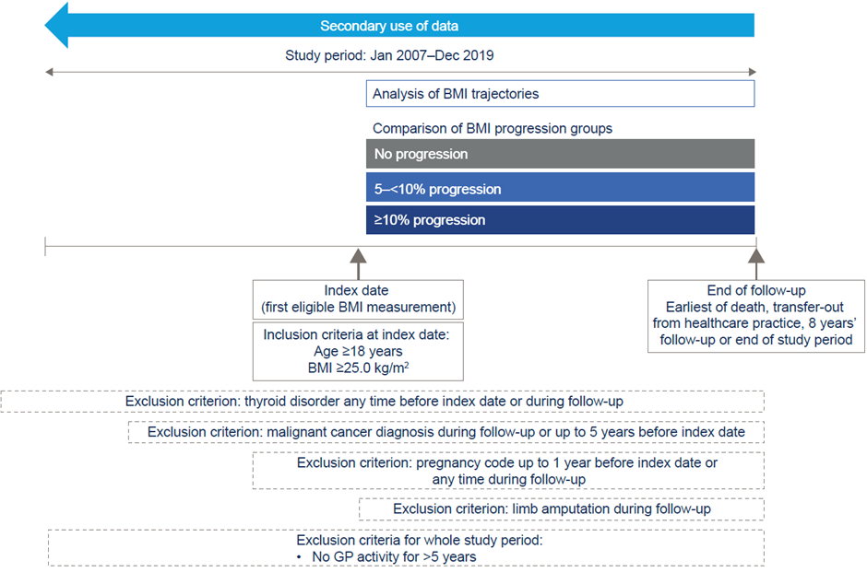
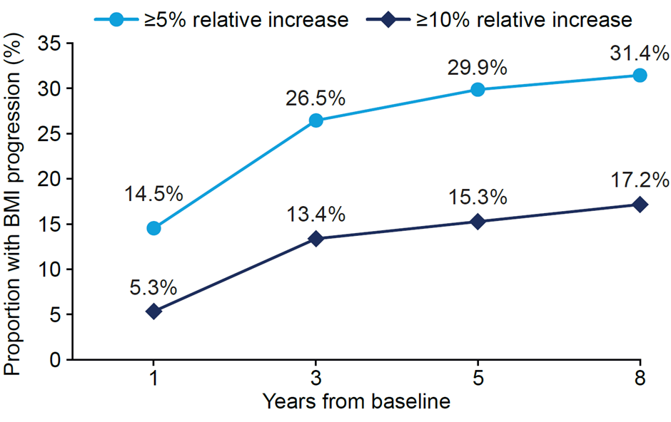
290,051 individuals from the Discover database of linked primary and secondary care records from 2.7 million individuals in North West London, UK .
Busetto L et al J. Adv. Ther. 2025;42:4626-4640.

Slide 20
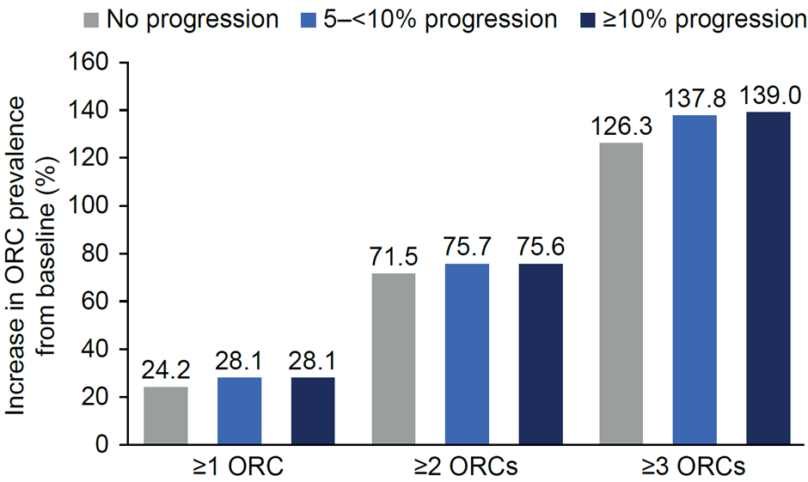
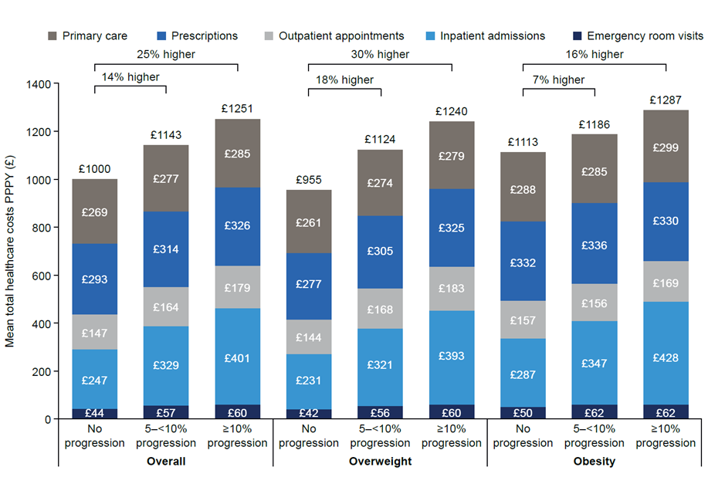
Busetto L et al J. Adv. Ther. 2025;42:4626-4640.

Slide 21






Grazie per
l’attenzione !!!
luca.busetto@unipd.it
Luca Busetto
@busetto_luca
luca.busetto.37

